Slide 1
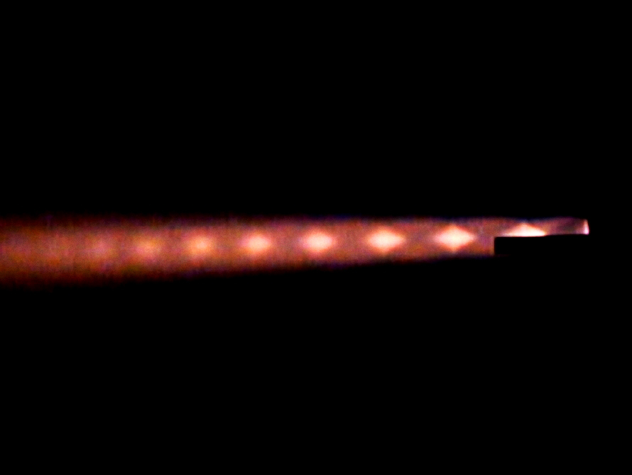
Brian’s Buddies
Max Wu | Michael Si | Whit Parker | Vivian Nguyen

Slide 2
Design Process
Designed simple grain to calibrate surface area-pressure relation
Analyzed pressure data to design appropriate CD nozzle
Used precision machining (e.g. CNC) to manufacture higher surface area grains
Iterated to maximize impulse while attempting to not foul

Slide 3
Lab Stock Rocket Firing
Stock nozzle: converging only (dia. = 0.701 in.)
Fuel grain: large circular hole
What we learned:
Maximum unchoked orifice pressure is ~1000 kPa.
Primarily want to burn more fuel for subsequent tests
Estimate of expansion ratio for converging-diverging nozzle

Slide 4
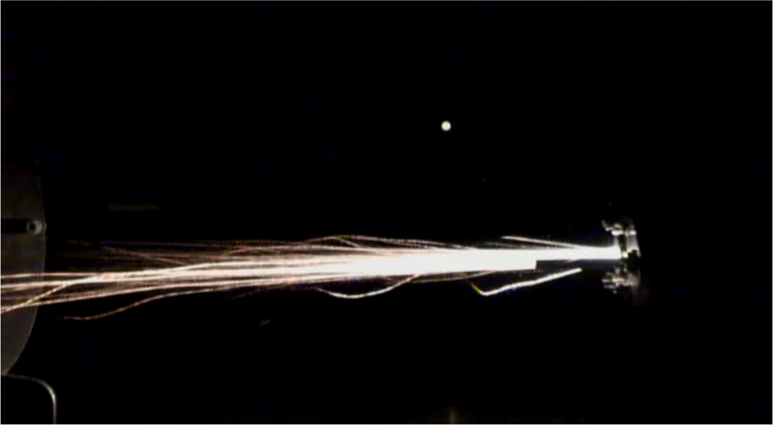
Lab Stock Rocket Firing

Slide 5
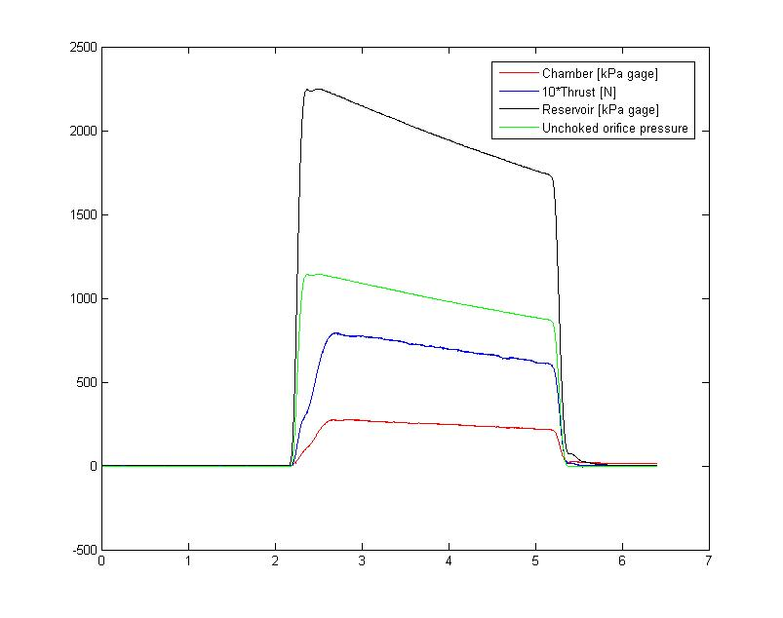

Slide 6
Properties | Value
Mixture ratio | 31.6
Impulse | 203.7 N-s
Specific impulse | 68.55 s
Fuel burned | 9.3 g
ɳc* | 24.5%
ɳcF | 80.3%

Slide 7
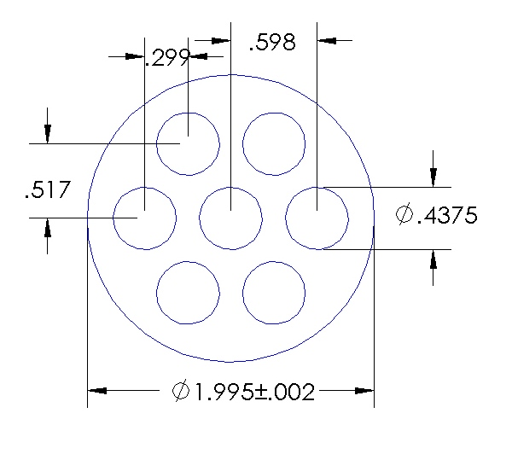
Test Firing 1
Stock nozzle: converging only (dia. = 0.701 in.)
Fuel grain: 7.375 in.

Slide 8
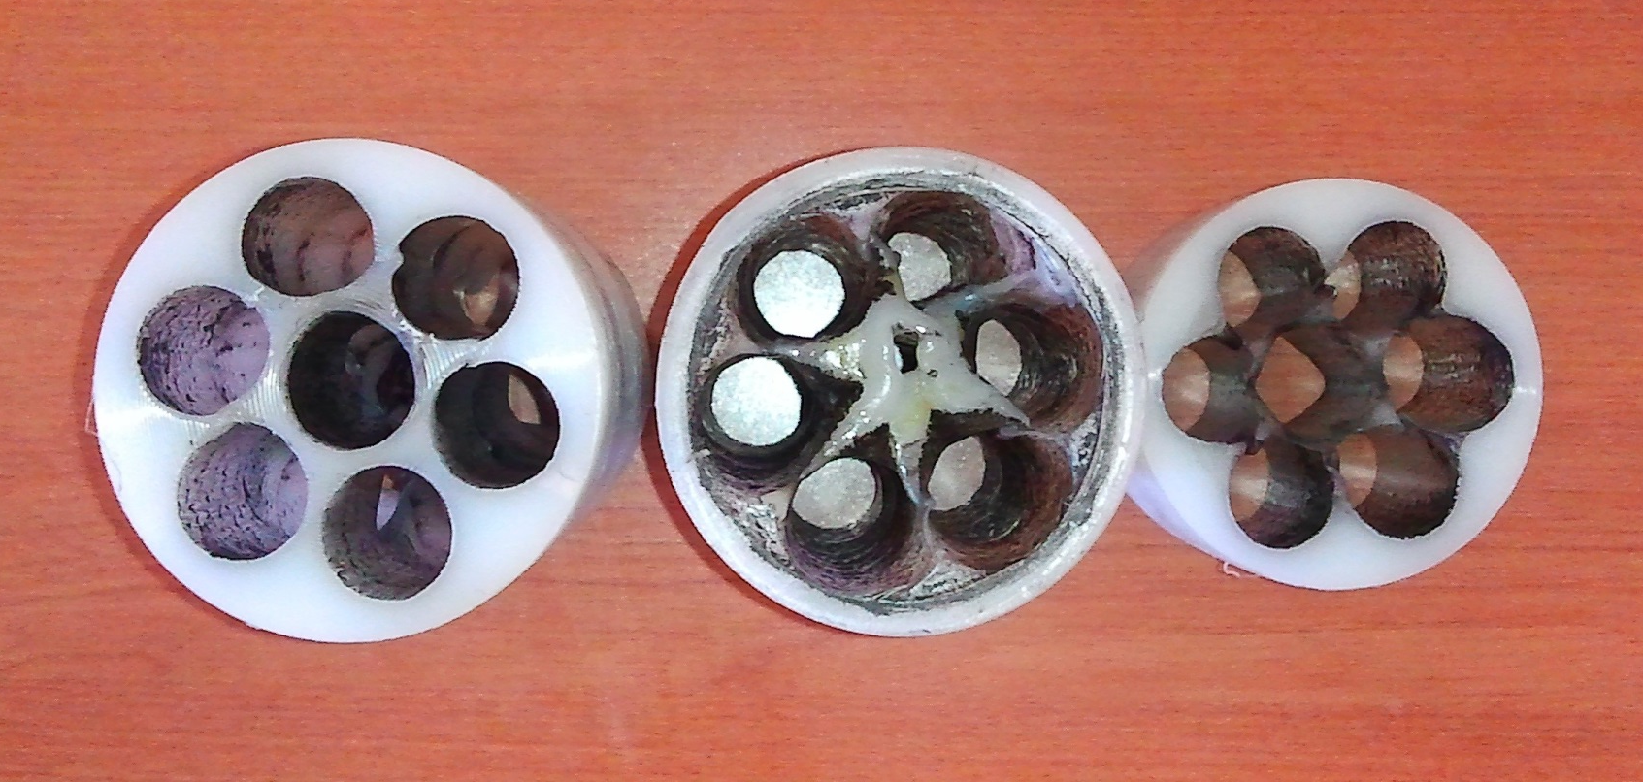
Test Firing 1
Post-firing

Slide 9
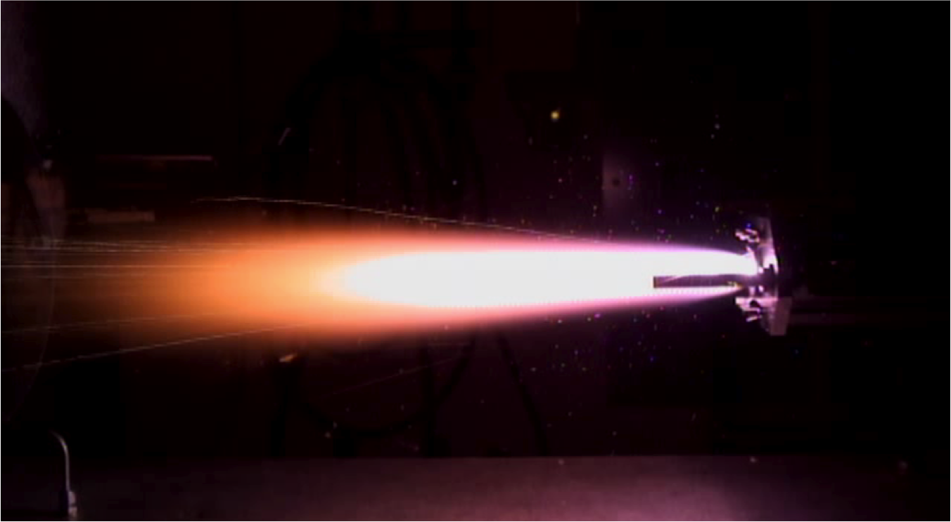
Test Firing 1

Slide 10
Test Firing 1
What we learned:
Test run gave us general calibrations for fuel burned, chamber pressure, impulse, etc.
Need to increase chamber pressure and surface area
Try grain design with smaller holes
Complicated grain designs not necessary due to orifice pressure limitation

Slide 11
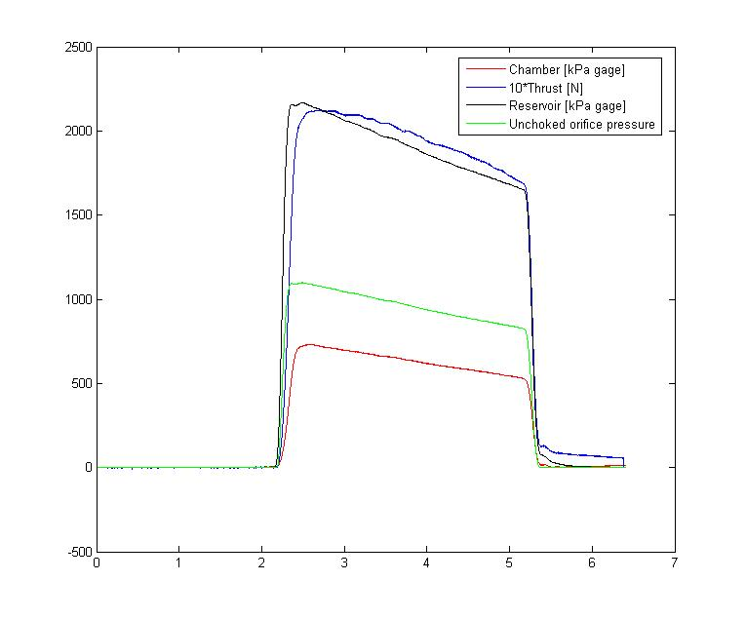

Slide 12
Properties | Value
Mixture ratio | 3.985
Impulse | 580.1 N-s
Specific impulse | 166.99 s
Fuel burned | 71.1 g
ɳc* | 65.9%
ɳcF | 88.3%

Slide 13
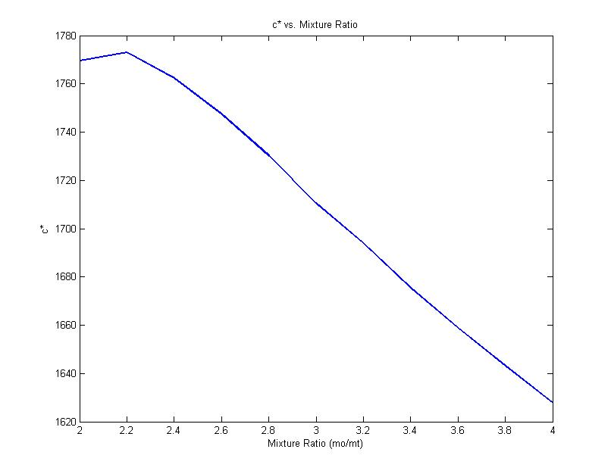
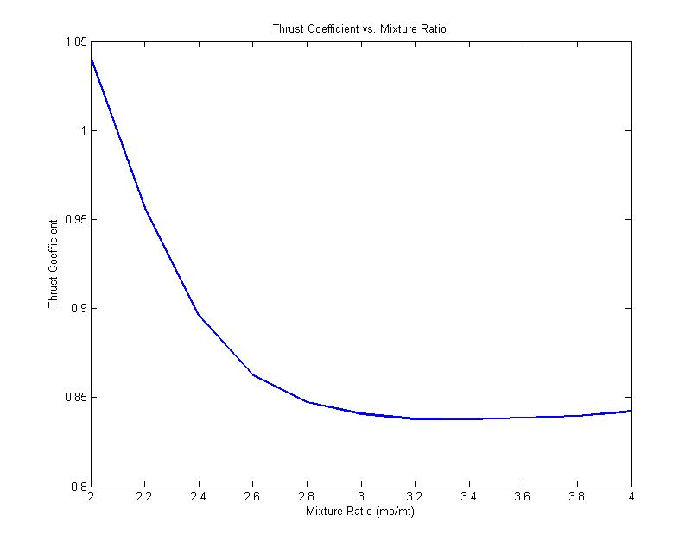
CD Nozzle Design

Slide 14
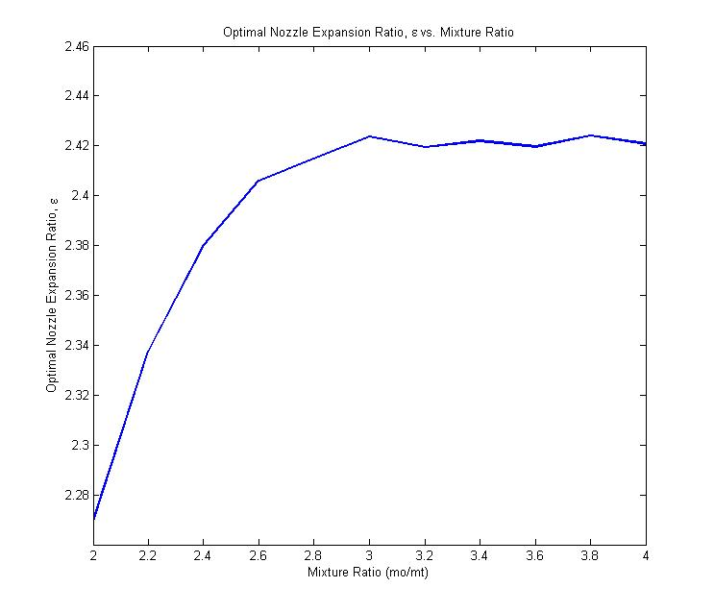
CD Nozzle Design

Slide 15
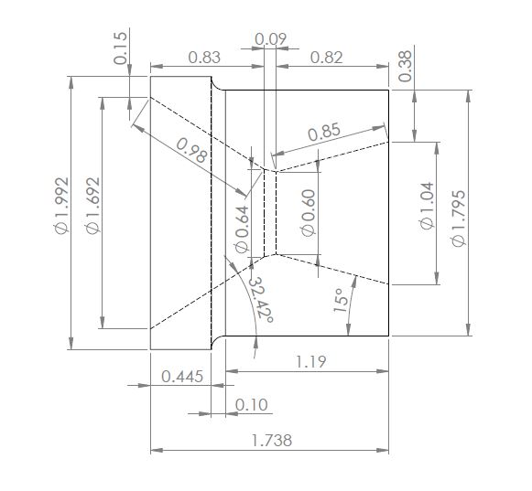
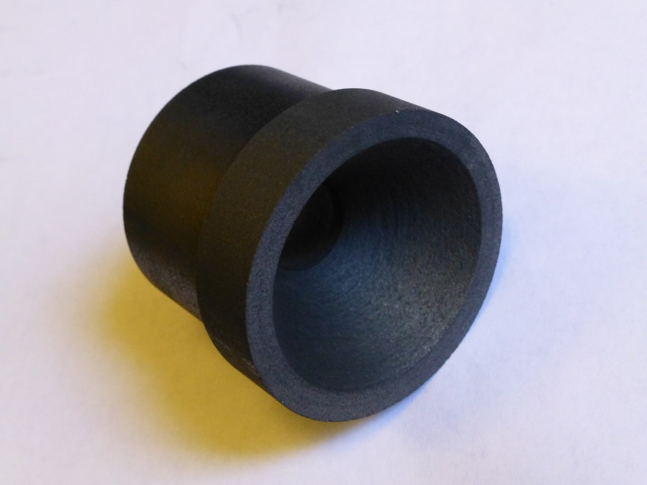
CD Nozzle Design
*Note: Before firing, throat
diameter was sanded down to 0.7”

Slide 16
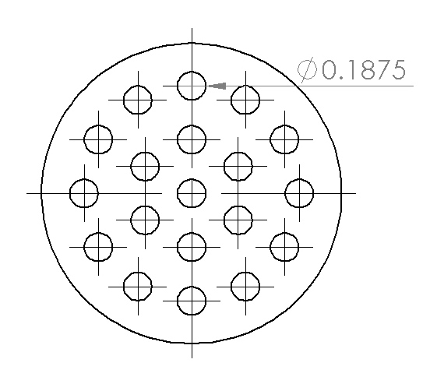
Test Firing 2
CD nozzle: expansion ratio 2.3
Fuel grain: 5.375 in.

Slide 17
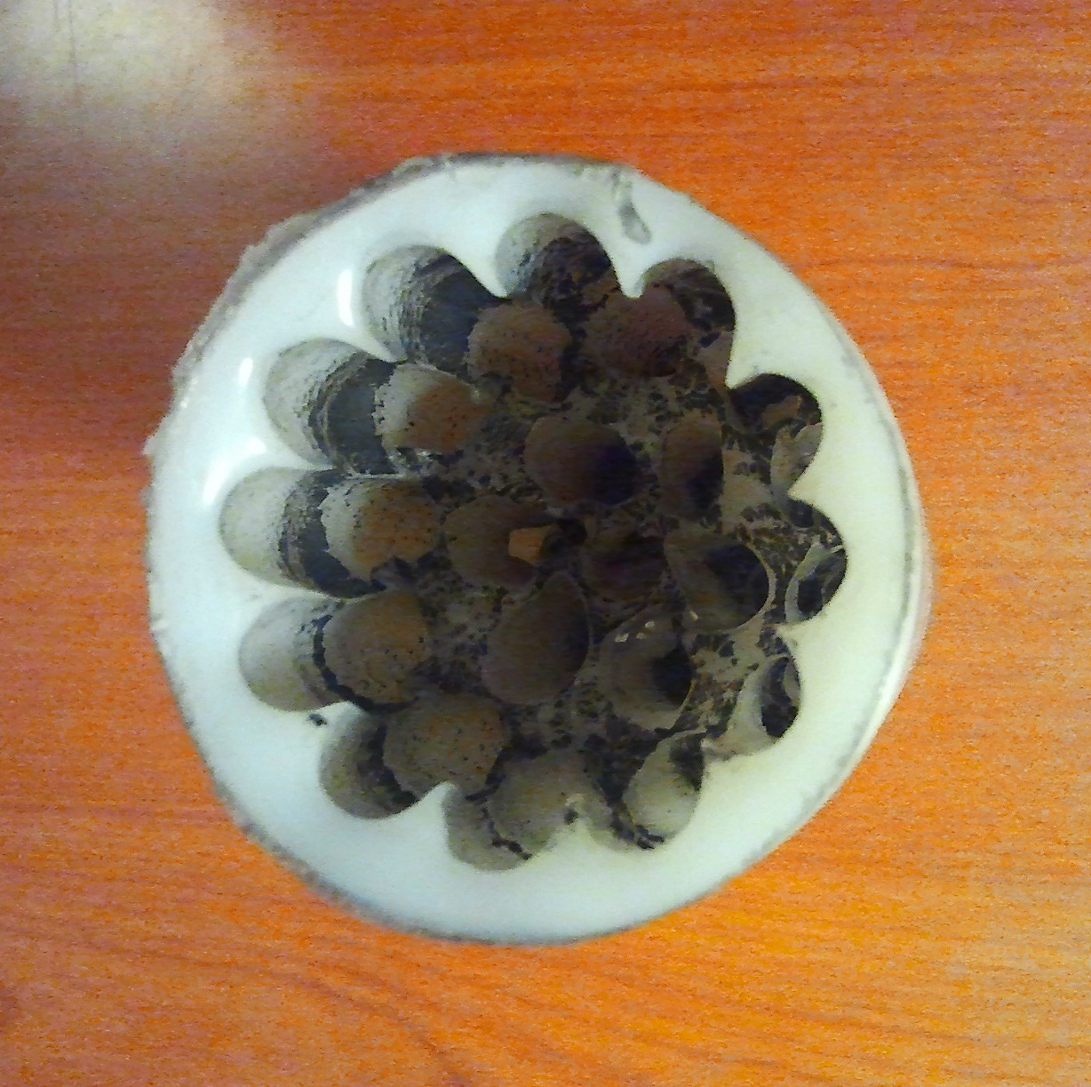
Test Firing 2
Post-firing

Slide 18
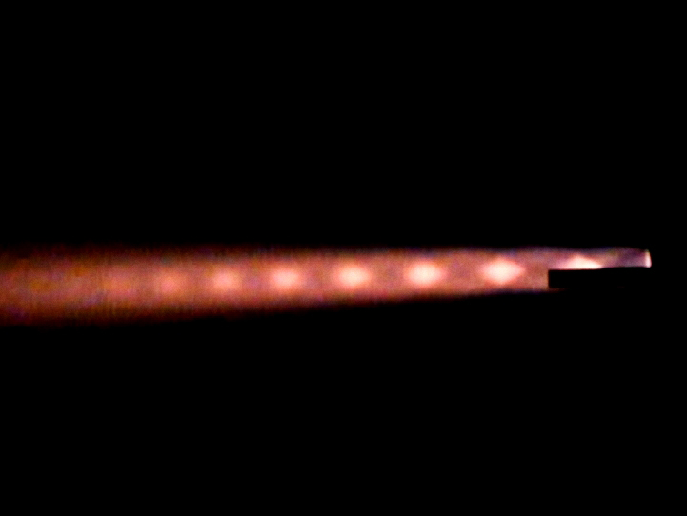
Test Firing 2

Slide 19
Test Firing 2
What we learned:
Burned out almost all fuel grain
Holes too constricted, caused foul
Need larger holes and less surface area

Slide 20
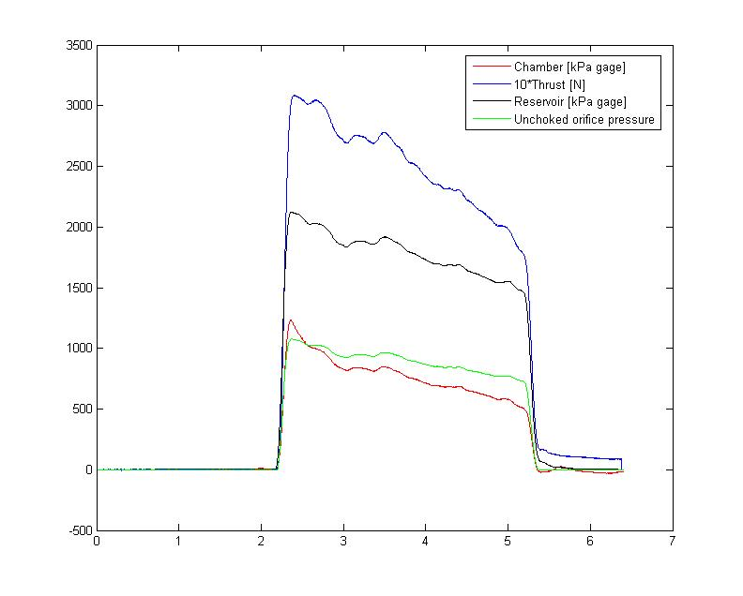

Slide 21
Properties | Value
Mixture ratio | 2.17
Impulse | 756.5 N-s
Specific impulse | 198.45 s
Fuel burned | 122.7 g
ɳc* | 86.2%
ɳcF | 91.3%

Slide 22
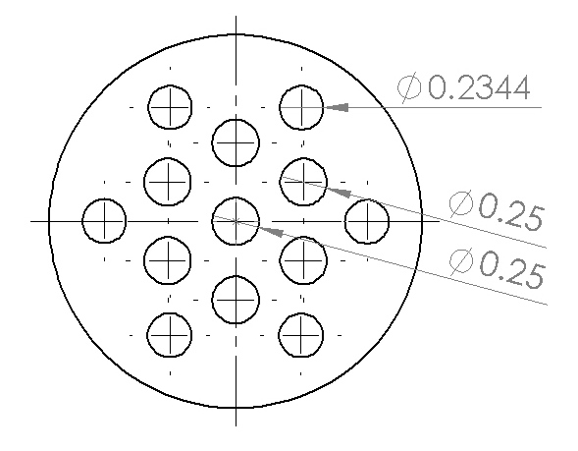
Test Firing 3
CD nozzle: expansion ratio 2.3
Fuel grain: 7.375 in.

Slide 23
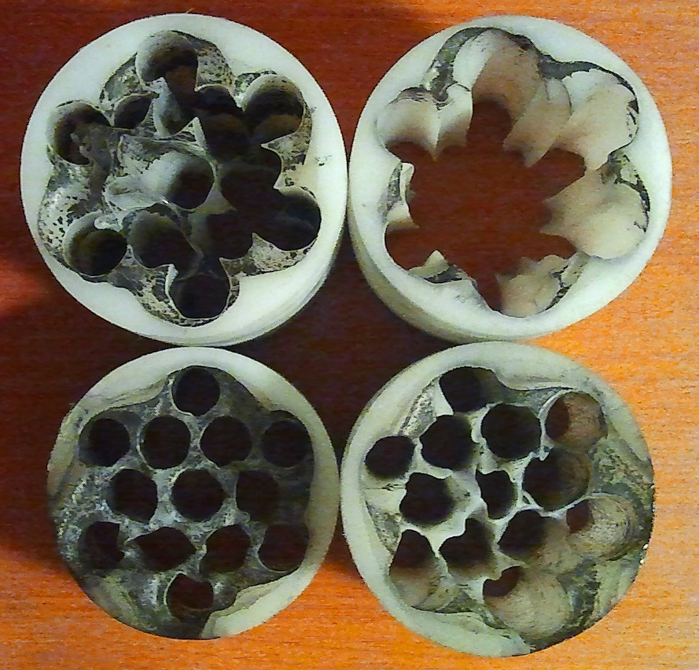
Test Firing 3
Post-firing

Slide 24
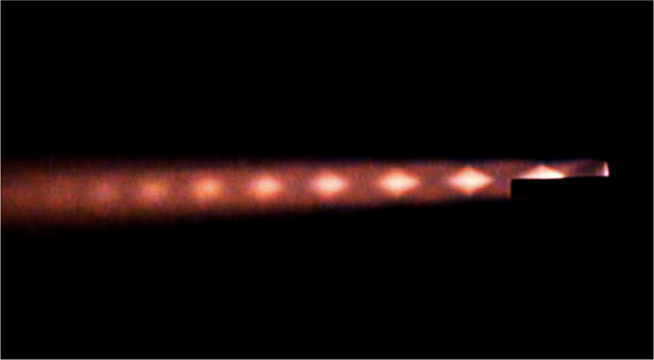
Test Firing 3

Slide 25
Test Firing 3
What we learned:
We had a good design, but a tiny foul
We needed to fine tune a little more, but ran out of time
Slightly increase throat diameter
Chamfer hole inlets for less restricted flow
Small factors, like alignment, can cause problems

Slide 26
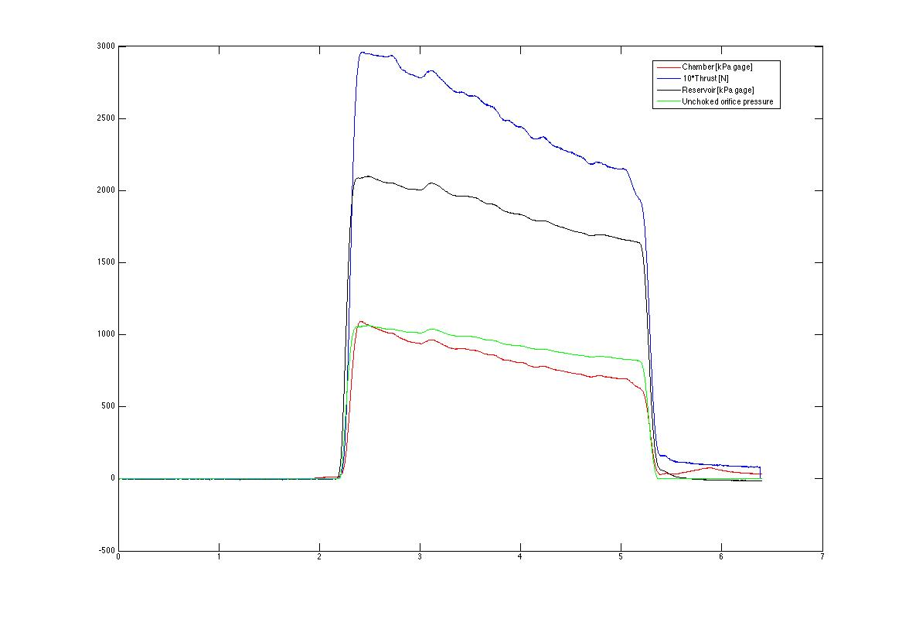

Slide 27
Properties | Value
Mixture ratio | 2.542
Impulse | 753.4 N-s
Specific impulse | 199.47 s
Fuel burned | 108.8 g
ɳc* | 89.1%
ɳcF | 84.2 %

Slide 28
Lessons Learned
Lessons Learned
Precision machining is critical
Increasing tolerances gives you more leeway
Timing is of the essence (especially with PRL reservations)
Checking parts are to spec before firing slot is key
Hole size can be more important than surface area
Simple designs are sufficient for limitations

Slide 29
Thank You!
¿Questions?

